Slide 1
Level 6 Group 9 Pitch 5
Thomas Simmons, Quwaine Dantes - McPherson, Callam Mutton

Slide 2
Brief Overview
Fiero and a zen like focus.
wont be considered another platformer clone/ generic platformer.
challenges the player
Immerses them into the game
Gameplay rather than the narrative.
QD

Slide 3
Logline
Ninja Bunnies, end the spider shoguns reign and free your villager rabbits
TS

Slide 4
Target Audience/Demographic
12 to 25 year old male and female casual gamers
TS

Slide 5
Chosen Game Idea: Ninja Rabbit
Must avoid samurai birds and spiders
retrieve the key to unlock new areas
Release villager prisoners
If the player is touched by an enemy they lose a life
Checkpoints throughout the level
TS

Slide 6
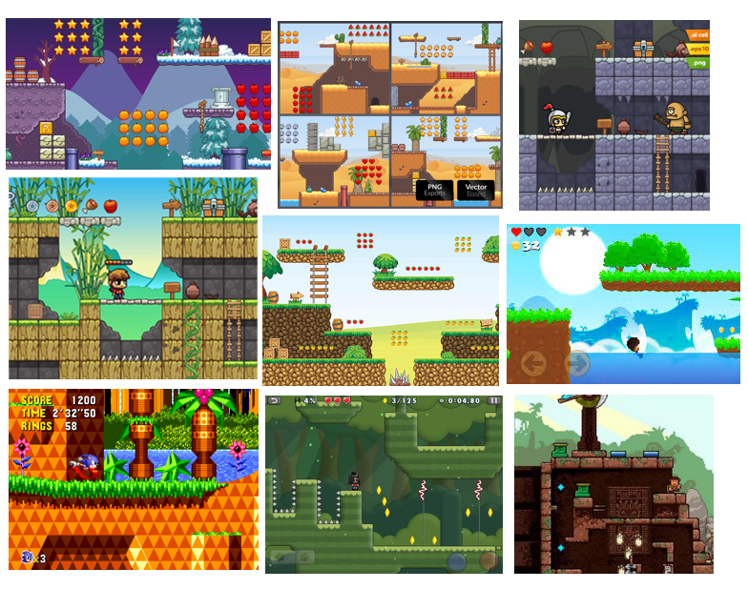

Mood boards

Slide 7
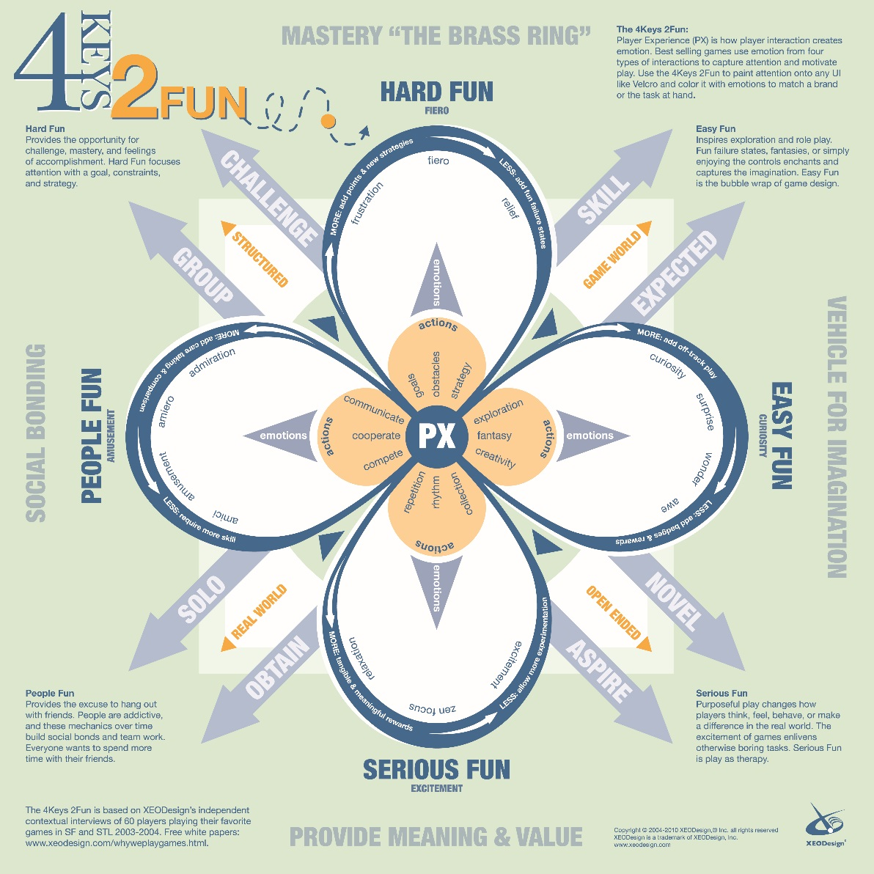
Keys of Fun
We will want to implement the following
Hard Fun: Fiero, Frustration, Relief
Easy Fun: Exploration, Surprise
Serious Fun: Zen Focus
QD

Slide 8
Level Design Loop
Explore
Avoid
Collect
Exploring game level
Avoiding enemies
Collecting bonus points

Slide 9
Gameplay Loop
Avoid
Destroy
Rescue
Exploring game level
Avoiding enemies
Collecting bonus points

Slide 10
Current Prototype

Slide 11
Player Reward
Collect ninja stars
Contribute to the players final score
Players reaching checkpoints
Rewards for killing/ avoiding enemies
CM

Slide 12
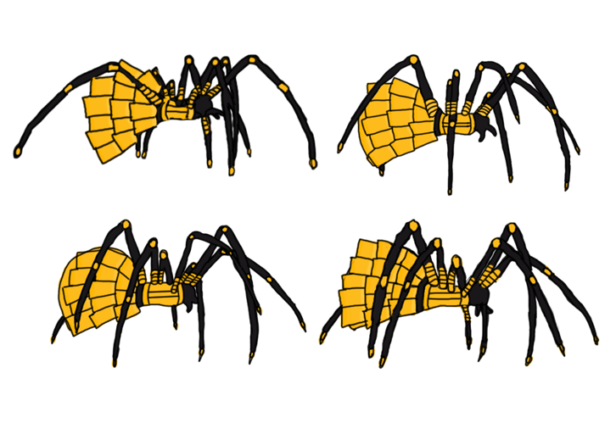
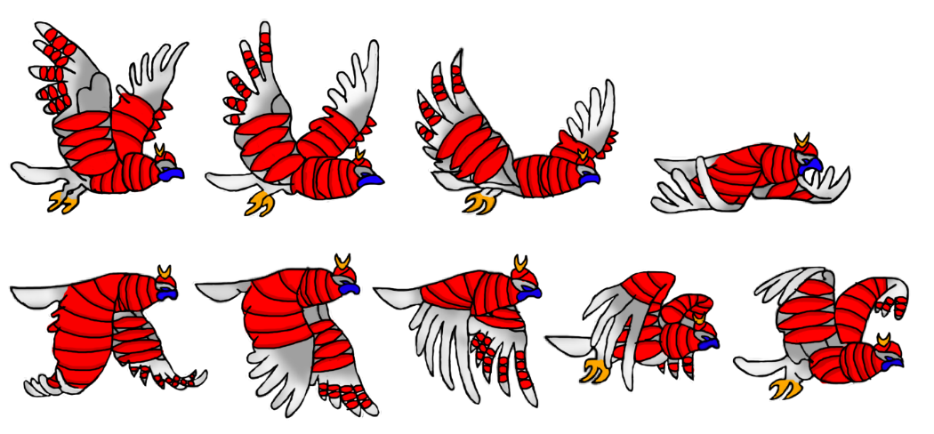
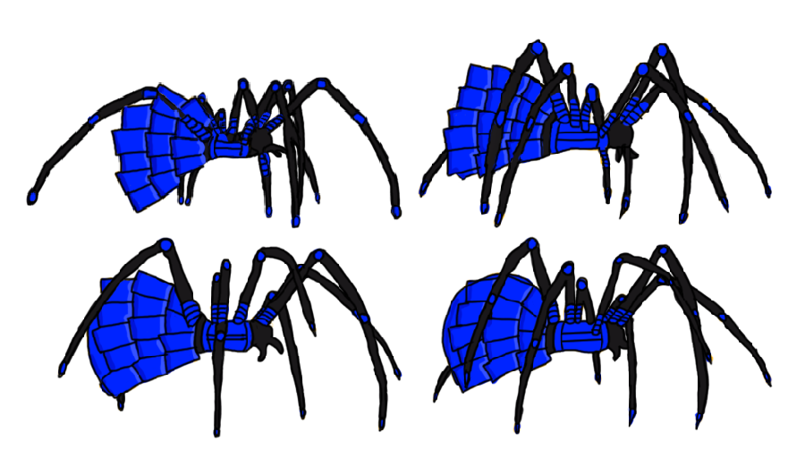
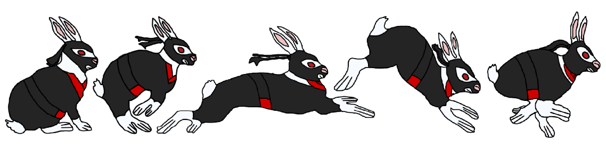
Character Artwork
TS

Slide 13

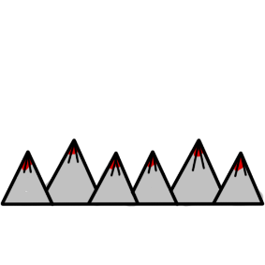




Props & Platformer Artwork

Slide 14
Any Questions?

